Slide 1

Anime
Analysis
Recommending
🤖️Anime Ratings Analysis &
🧚Recommending System
Group2: Jingwen Qiu, Yuchen Chang
DATA APP

Slide 2
1
PART
Title
PART
2
Dataset
PART
3
Analysis
CONTENT
PART
4
Data App Demo

Slide 3
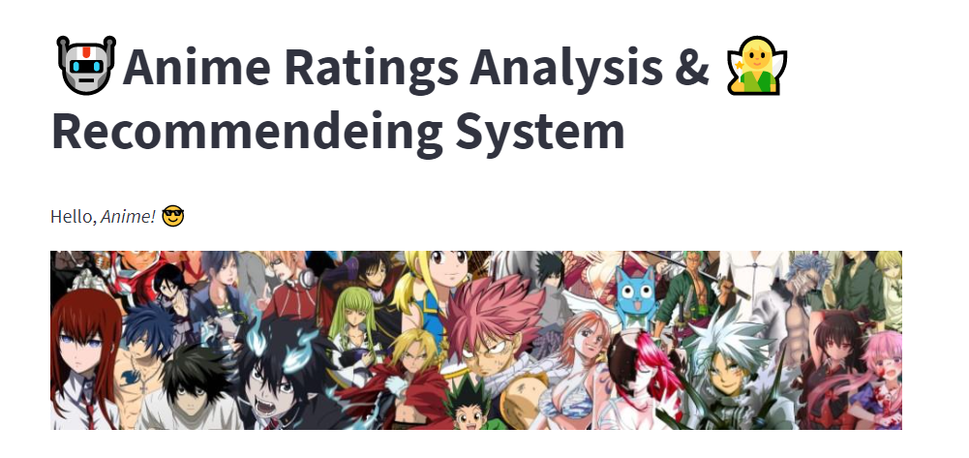
PART 1
Title

Slide 4
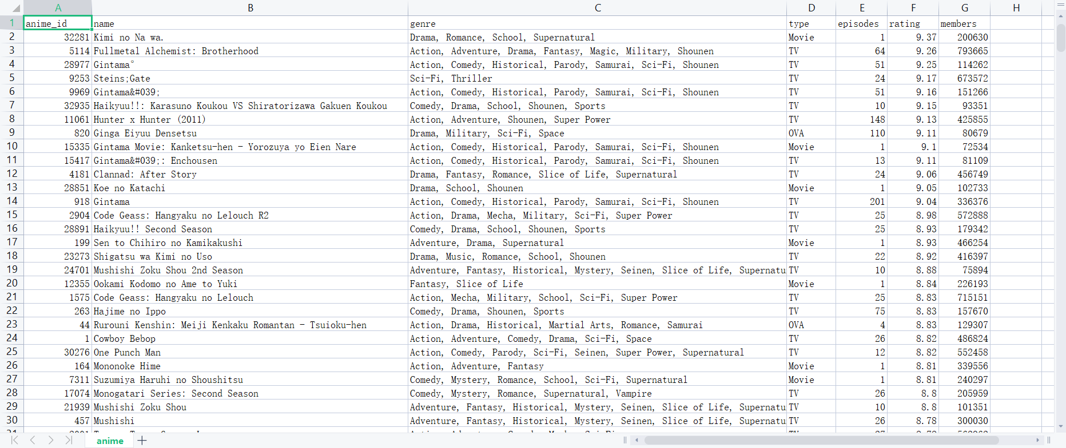
PART 2
Dataset

Slide 5
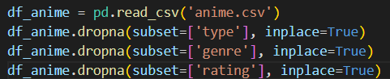
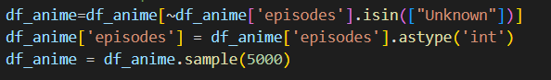
Data Preprocessing
Step 1: Remove the null values from the data
Step 2: Convert the episodes from the string to the int type

Slide 6
PART 3
Analysis
Our analysis will include two parts: questions with explaination and other simple charts

Slide 7
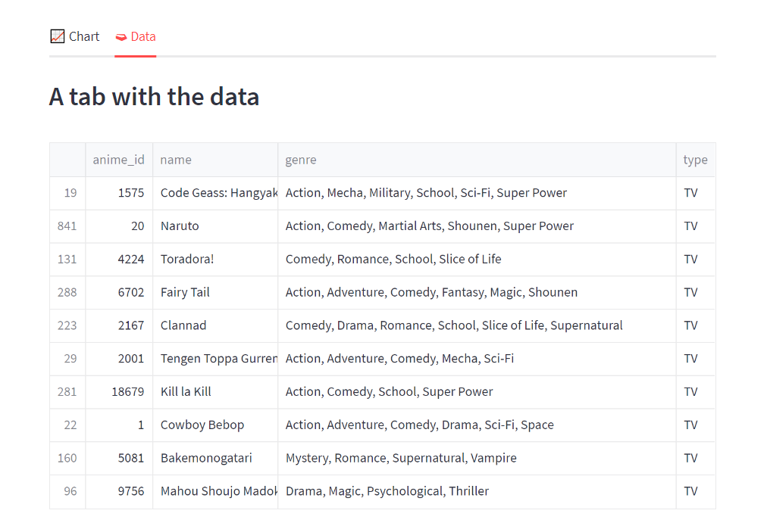
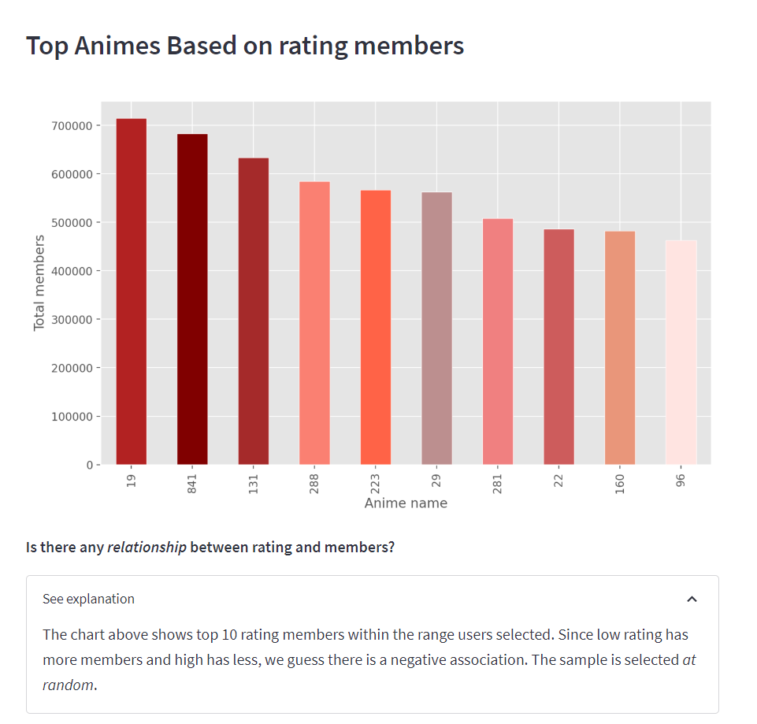
Question 1
See explaination here➡️
Is there any relationship between rating and rating members?
🤔️

Slide 8
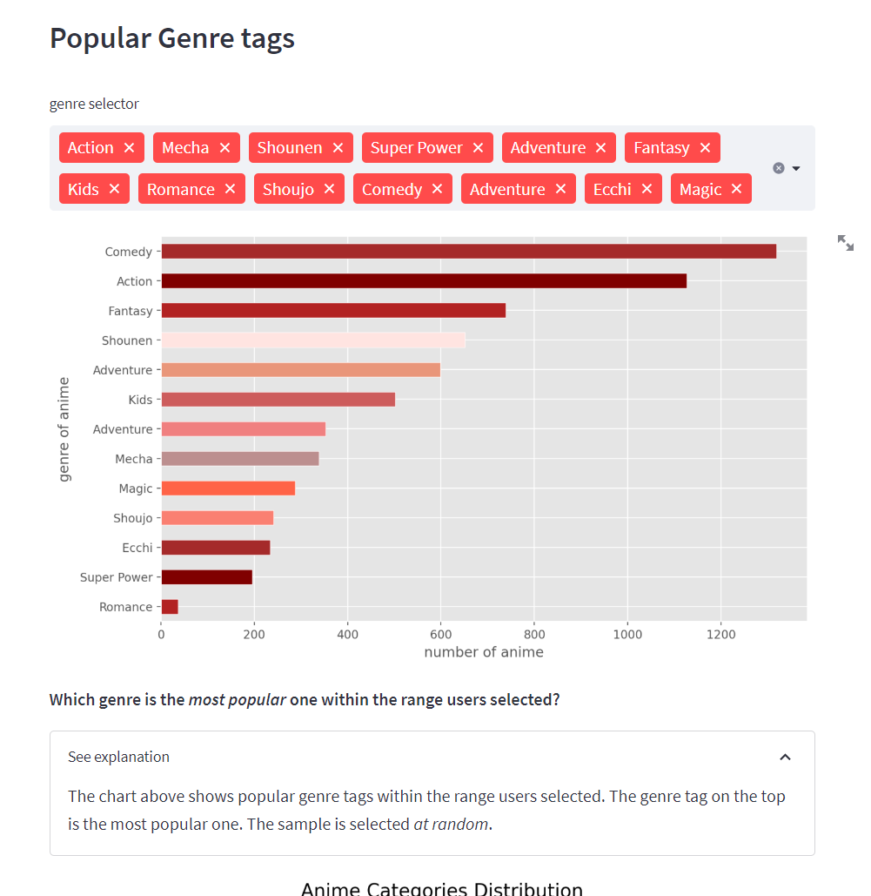
Question 2
😯
You can see⬅️
Which genre is the most popular one within the range users selected?

Slide 9
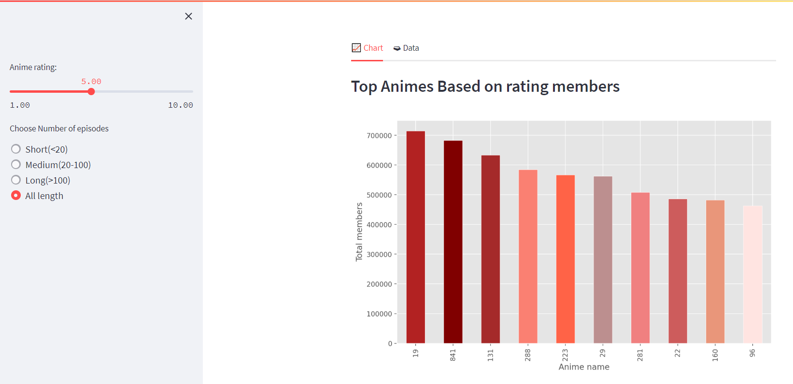
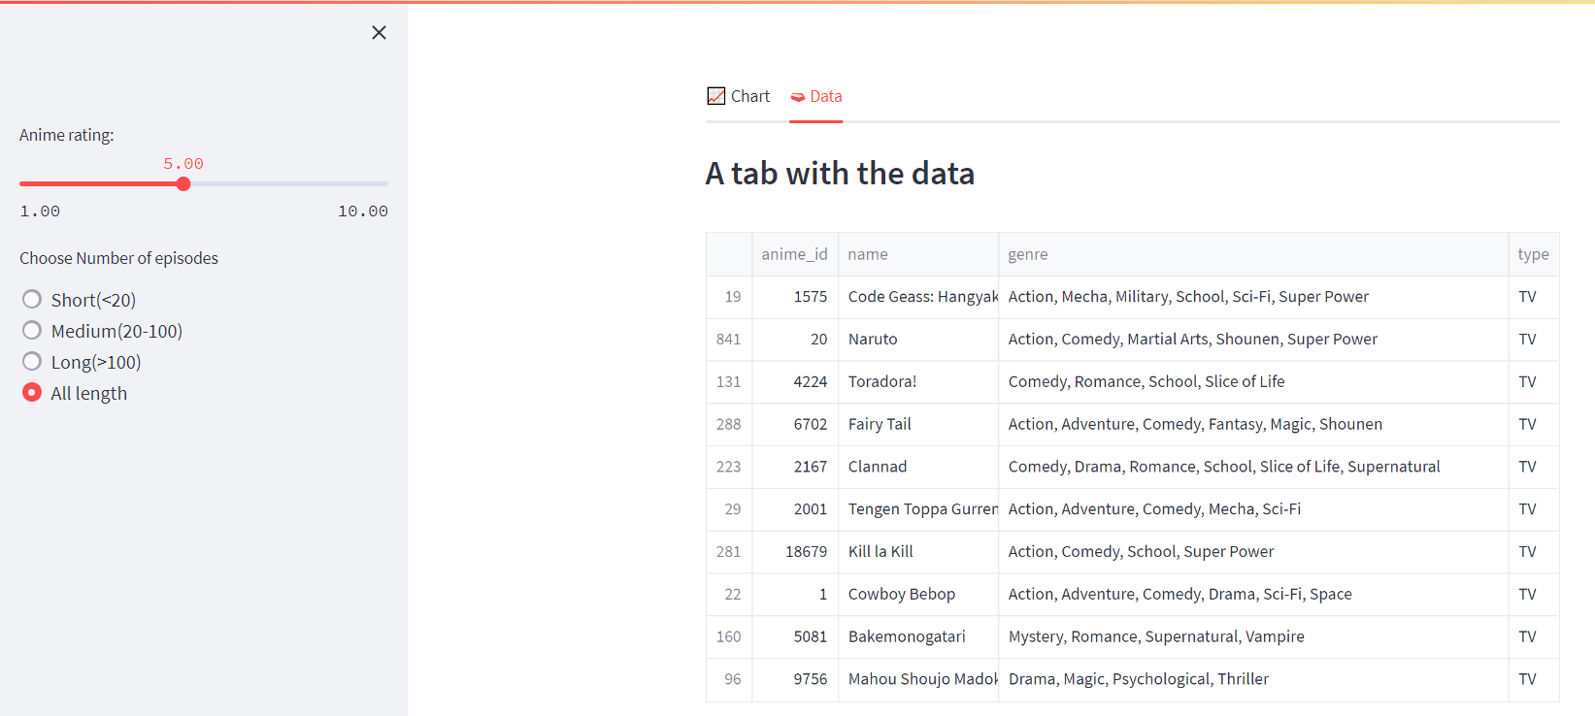
Other Charts-Filters
Chart
Data
Slider and Multiselect filtering widgets are used to assist the layout
And you can see the detailed data as you like it

Slide 10
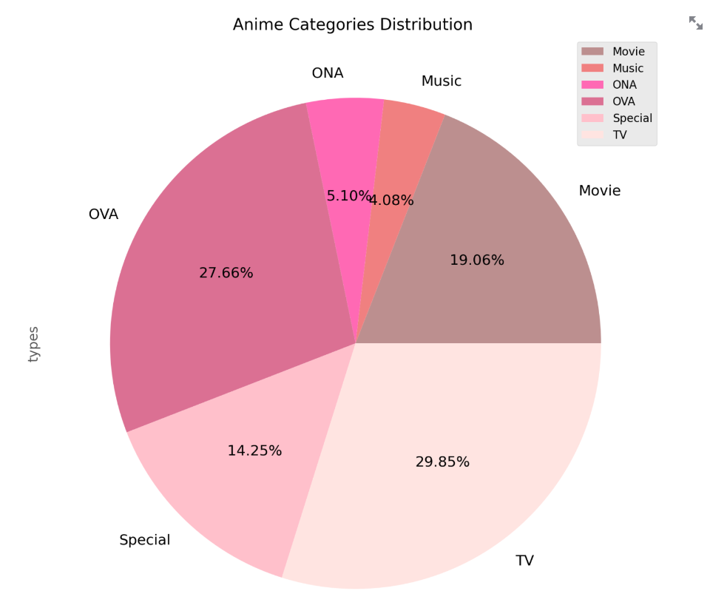
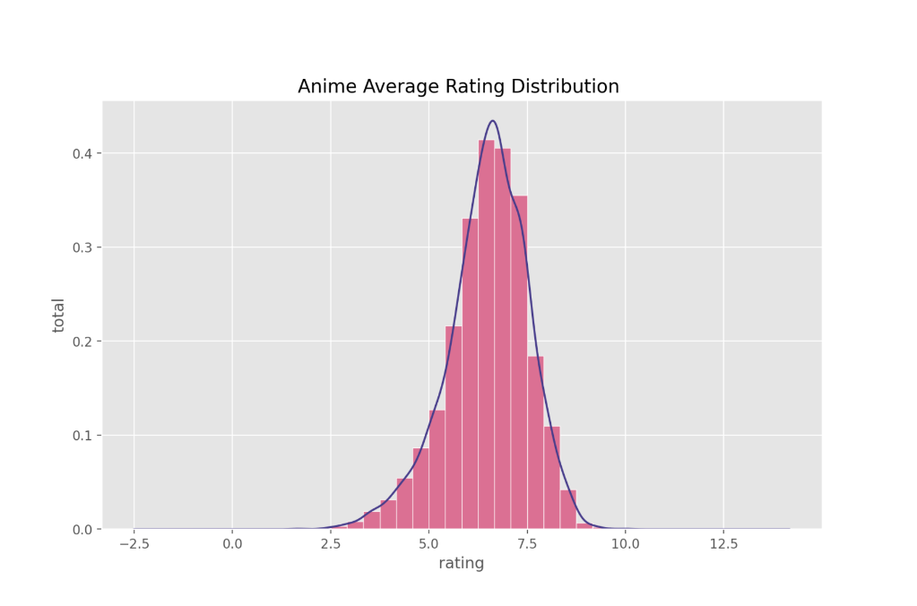
Other Charts
Pie Chart
Distribution Plot
Proportions of types are calculated and made into a pie chart
Outcomes of rating and its trend are made into distribution plot

Slide 11
Data App Demo
Let’s see what we have!!!
😎

Slide 12
THANK YOU
From Group 2 ✌️

